Slide 1

Smart Alarm System Using Motion Detection

Slide 2
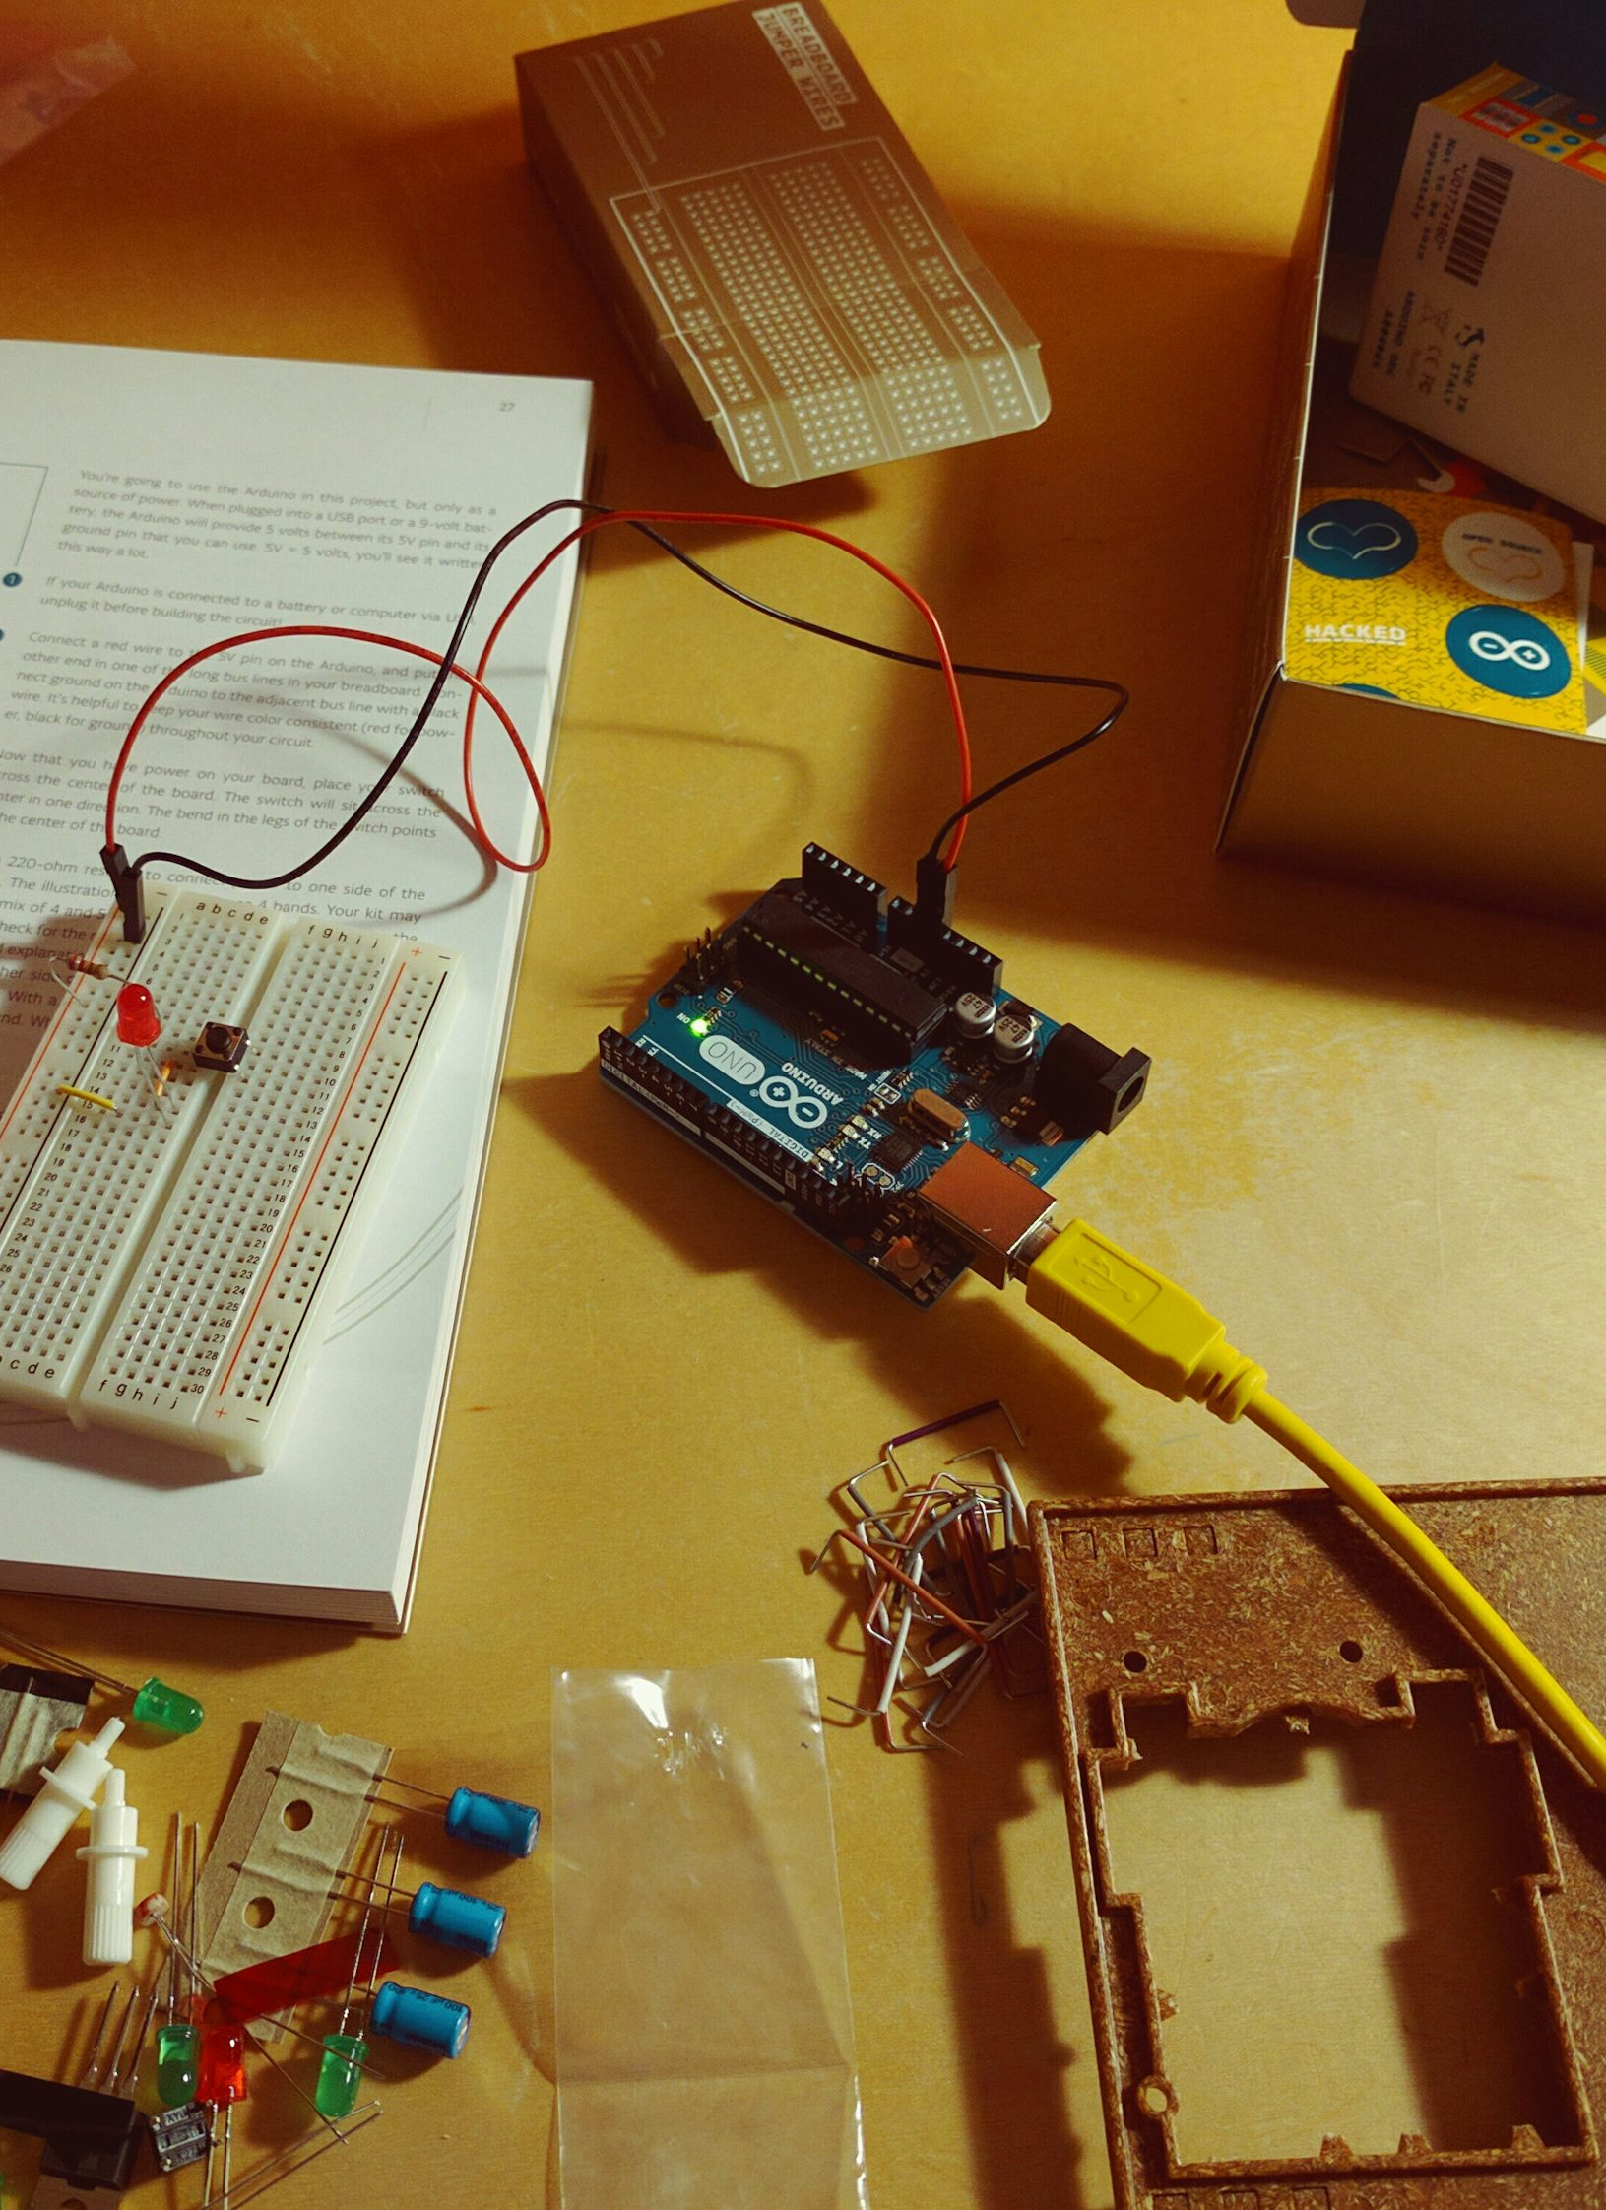
Aim
The Smart Alarm System is an ultrasonic sensor based alarm. It is distance sensitive so the speed of the buzzer depends upon how close or far the object is. If the object is near then the buzzer beeps faster and if it far then the buzzer beeps slowly.

Slide 3
Components Required
Microcontroller: Arduino Uno
Ultrasonic Sensor: HC-SR04.
Buzzer: For the Buzzing Noise.
Power Source: Battery or USB power supply.
Jumper Wires: For connections.
Breadboard: For prototyping.

Slide 4
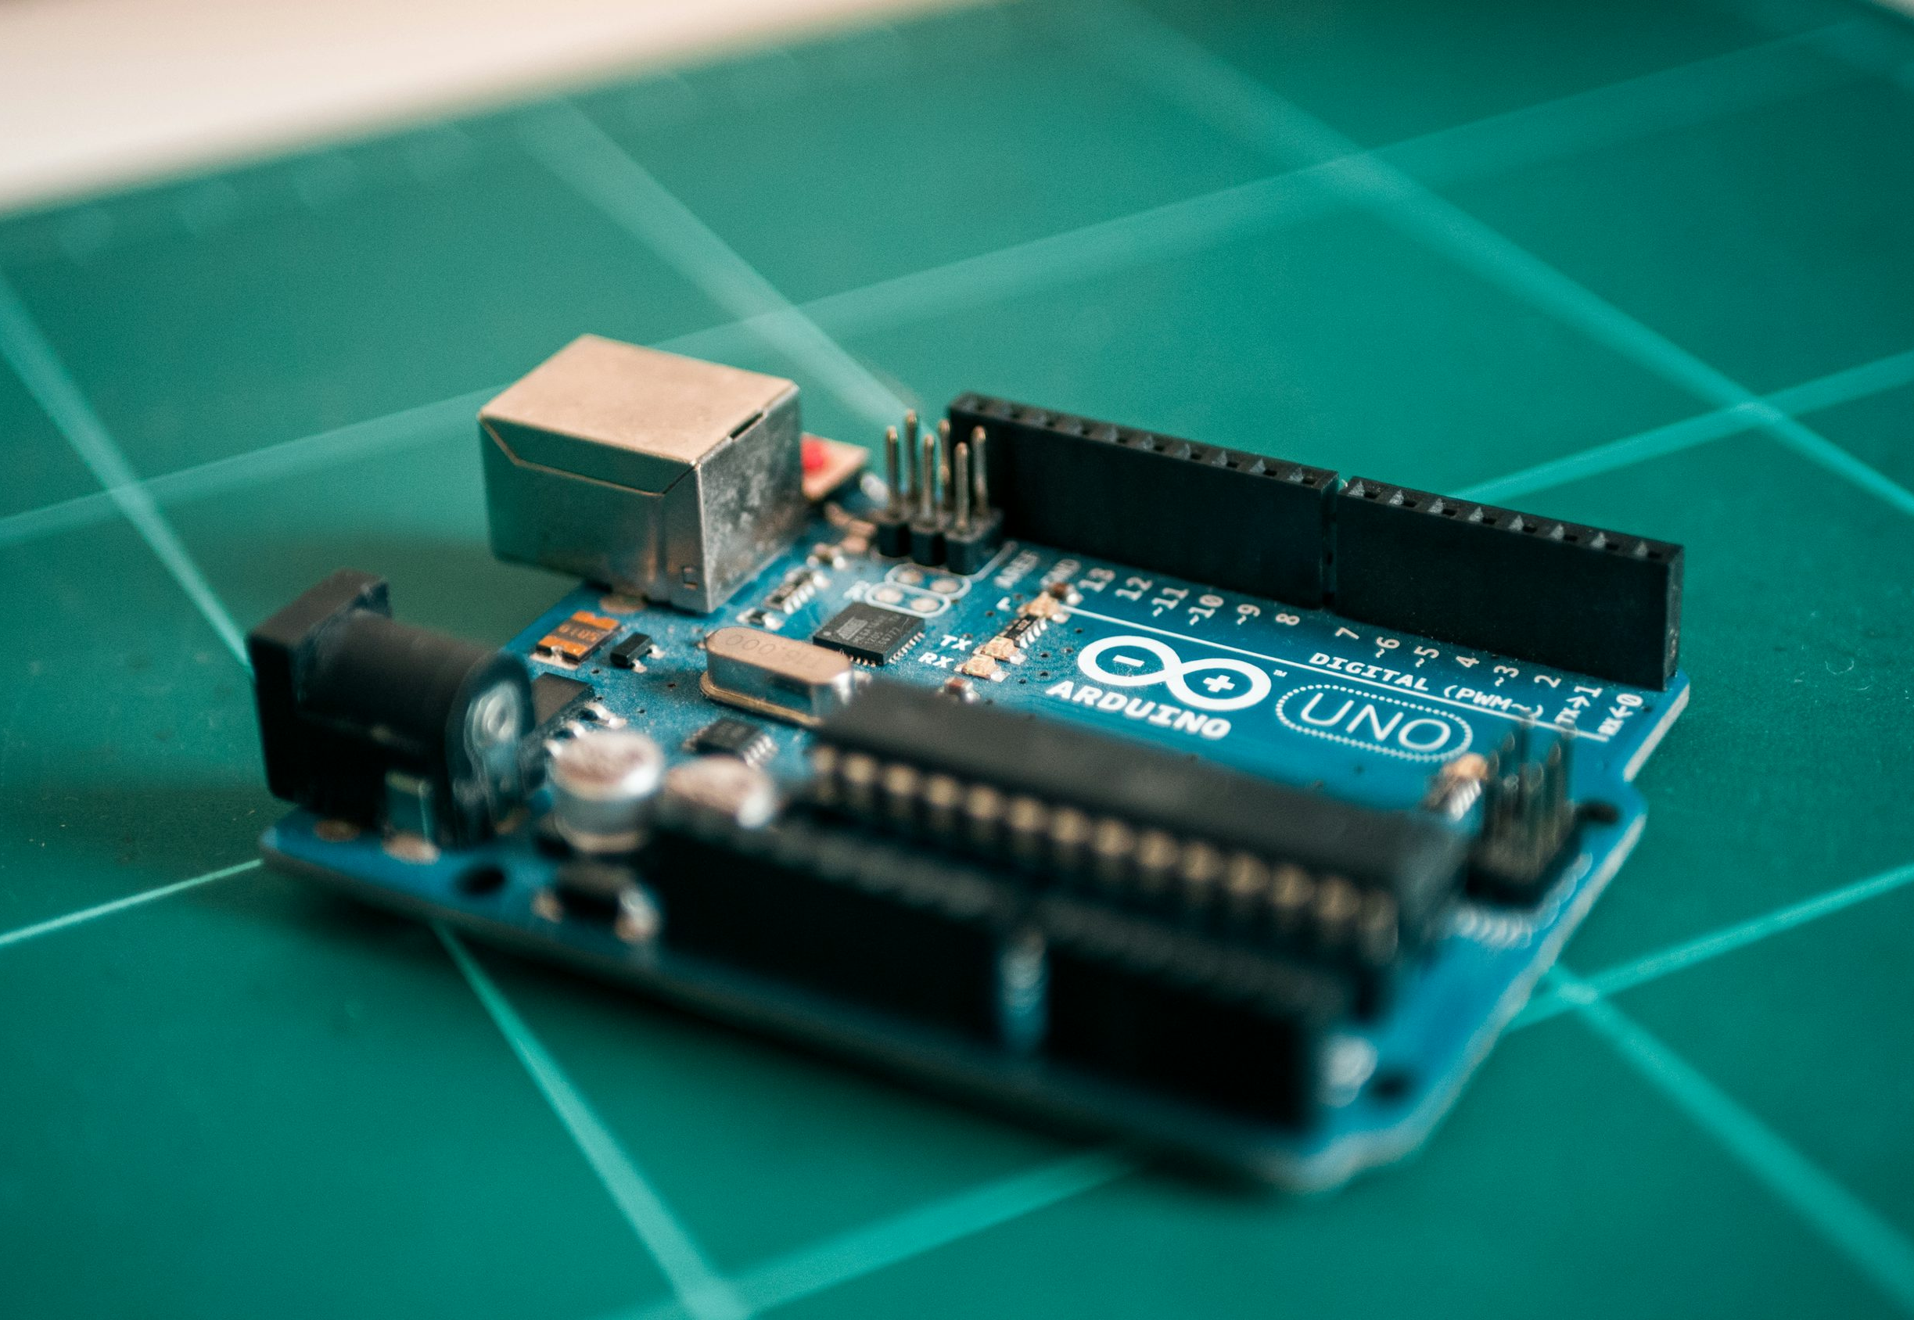
Arduino UNO
The Arduino board serves as the central control unit for the smart dustbin. It processes input from the ultrasonic sensor and controls the servo motor to automate the lid's movement.

Slide 5
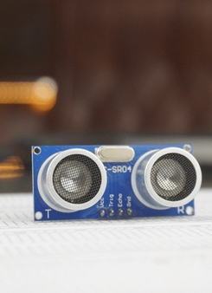
Ultra-Sonic Sensor
The HC-SR04 ultrasonic sensor is a widely used component for distance measurement in automation projects like the smart dustbin. It works by emitting ultrasonic waves and measuring the time taken for the echo to return after hitting an object.
Range: Measures distances between 2 cm to 400 cm.
Accuracy: High precision with a resolution of approximately 3 mm.
Voltage: Operates on 5V DC.
Compact Design: Easy to integrate into small projects.

Slide 6
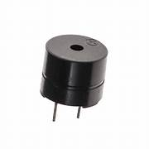
Buzzer
A buzzer or beeper is an audio signaling device, which may be mechanical, electromechanical, or piezoelectric (piezo for short). Typical uses of buzzers and beepers include alarm devices, timers, train and confirmation of user input such as a mouse click or keystroke.

Slide 7
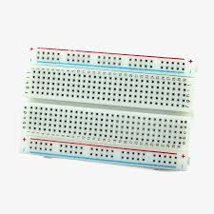
Bread Board
A breadboard, also known as a solderless breadboard or protoboard, is a tool used for prototyping and building temporary electronic circuits without soldering, allowing for easy component placement and modification

Slide 8
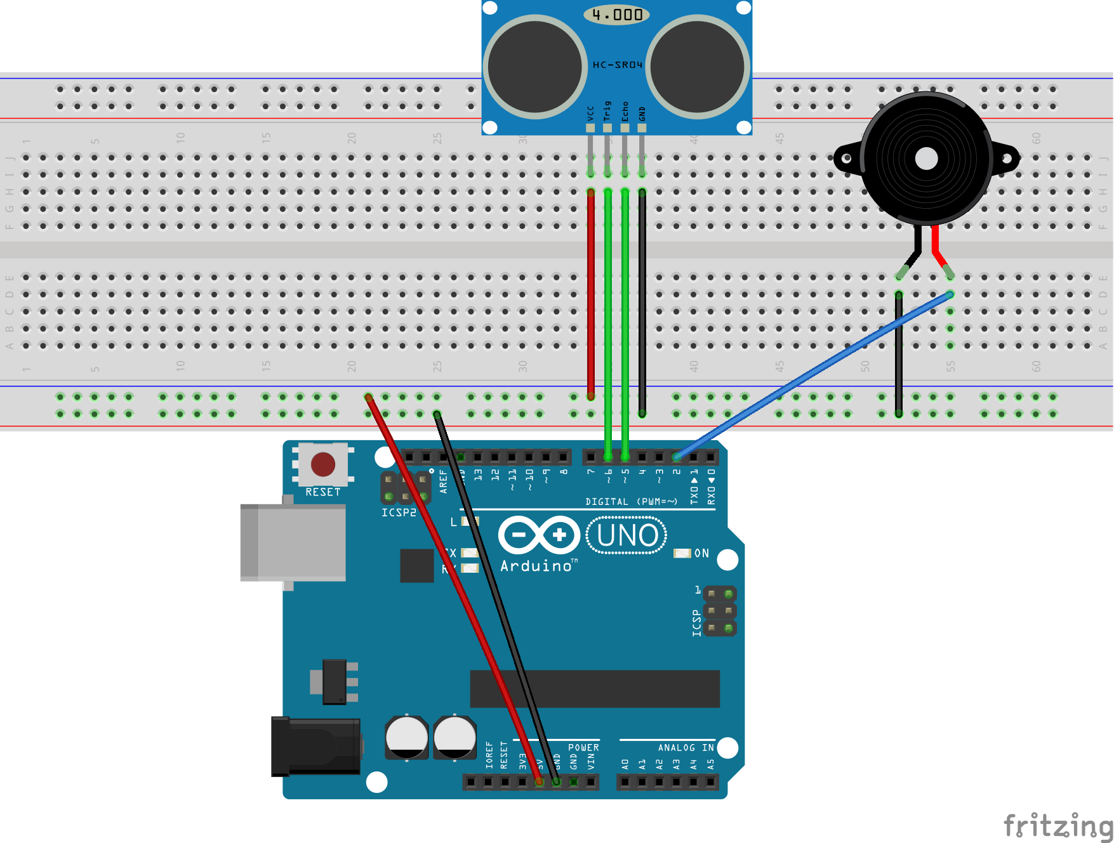
Circuit Diagram

Slide 9
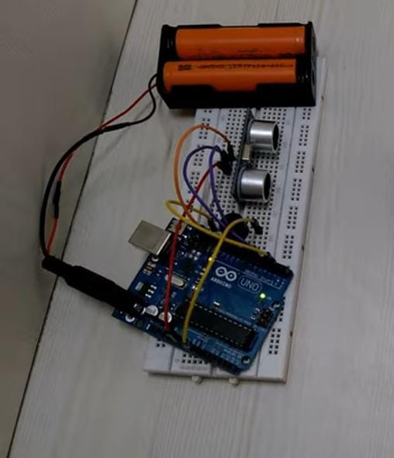
Working Of Smart Alarm System
The ultrasonic sensor detects an object within the threshold distance.
The Arduino Uno processes this input and sends a signal to the Buzzer.
The Buzzer start to make the buzzing Noise.

Slide 10
Thank You!

